Slide 1

Experiment 3 K-Nearest Neighbors for Classification
Acknowledge to: Guoqiang Zhong
Organizers: Guoqiang Zhong, Zhaoyang Niu
Machine Learning Research Group
Ocean University of China
Qingdao, China

Slide 2
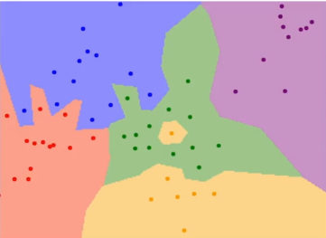
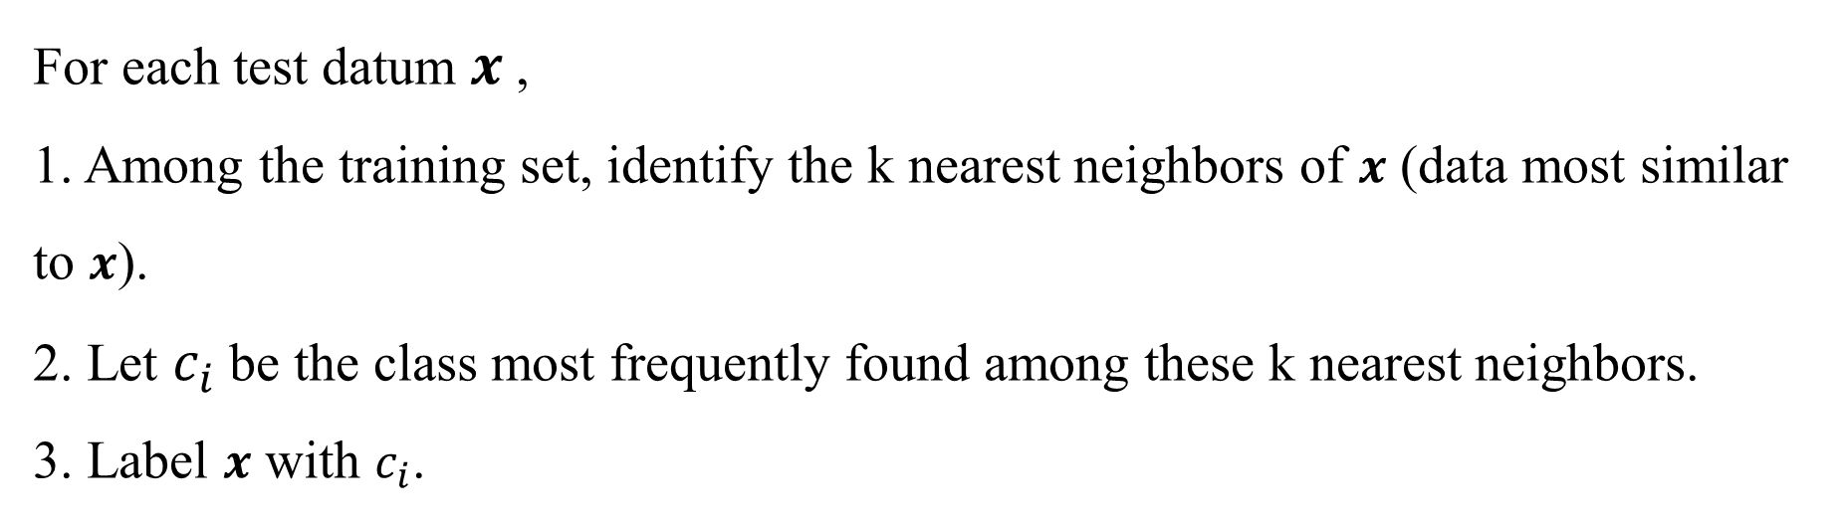
K-nearest neighbors for classification
Given a training data set and a test data set, for k-nearest neighbors (k-NN) classification, we apply the Euclidean distance to measure the similarity between a pair of data. The k-NN classifier performs as the following steps.
For each test datum $x$,
1. Among the training set, identify the k nearest neighbors of $x$ (data most similar to $x$).
2. Let $c_{i}$ be the class most frequently found among these k nearest neighbors.
3. Label $x$ with $c_{i}$.

Slide 3
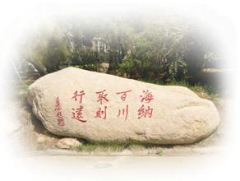
Experiment
Download a classification dataset from the UCI machine learning repository (https://archive.ics.uci.edu/ml/datasets.php).
Split the dataset into a training set and a test set.
Write the Python code of k-nearest neighbors to solve the classification problem.
Submit your compressed code, result and report in one week to DL2021Spring@163.com. The code should be reproducible, the result includes classification accuracy on the test set, visualization and that for analysis, while the report introduces the detailed process of your experiments.

Slide 4
Thank you!

